Slide 1
Capstone Engagement
Assessment, Analysis, and Hardening of a Vulnerable System

Slide 2
Table of Contents
This document contains the following sections:
01
Network Topology
02
Red Team: Security Assessment
03
Blue Team: Log Analysis and Attack Characterization
Hardening: Proposed Alarms and Mitigation Strategies
04

Slide 3
Network Topology
‹#›

Slide 4
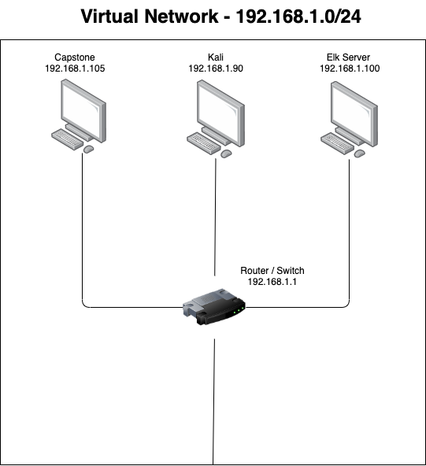
Network Topology
Network
Address Range: 0/24
Netmask: 255.255.255.0
Gateway: 192.168.1.1
Machines
IPv4: 192.168.1.105
OS: Linux
Hostname: server1
IPv4:192.168.1.90
OS: Linux
Hostname: Kali
IPv4: 192.168.1.100
OS:Linux
Hostname: ELK
IPv4:
OS:
Hostname:

Slide 5

Red Team
Security Assessment
‹#›

Slide 6
Recon: Describing the Target
Nmap identified the following hosts on the network:
Hostname | IP Address | Role on Network
Server1 | 192.168.1.105 | Website Database
Kali | 192.168.1.90 | Attack Machine / Kali Linux OS
ELK | 192.168.1.100 | SIEMs Web Server
Gateway | 192.168.1.1 | Gateway

Slide 7
Vulnerability Assessment
The assessment uncovered the following critical vulnerabilities in the target:
Vulnerability | Description | Impact
Broken Authentication | Authentication and session management are often implemented incorrectly | Attacker are able to compromise login credentials and gain access to sensitive information
Security Misconfiguration | Instruction on how to upload to the web server, were on the web server. | Allows a user to upload files to web server in any format
Remote Code Execution | A user is able to execute code remotely | A php would be able to execute unbeknownst to the owner of the website
Unrestricted File Upload | A user is able to upload a file without authentication of a session to a web server. | A unauthorized file would be uploaded to a web server that could potentially harm your server.

Slide 8
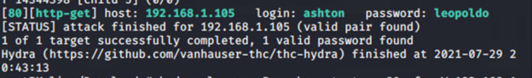
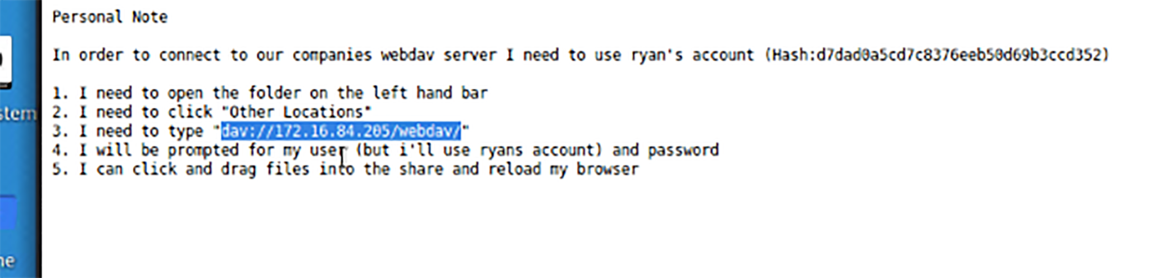
Exploitation: [Broken Authentication]
01
02
03
Tools & Processes
Used Company Directory to figure out usernames
Then used hydra to brute force ashton password and access the secret folder and instruction on how to upload files to the server
Achievements
We were able to access secret files including instruction on how to upload files to the web server with DAV

Slide 9
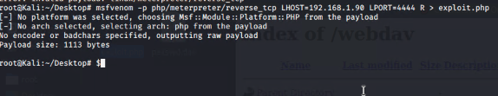
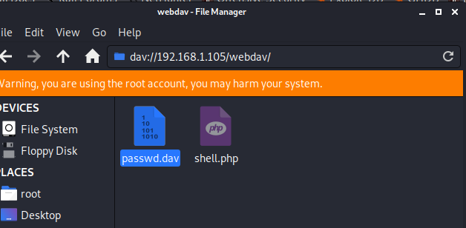
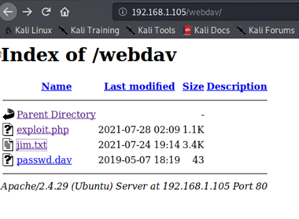
Exploitation: [Security Misconfiguration]
01
02
03
Tools & Processes
MSFVENOM
FTP
Achievements
Able to Access secret folder directory on remote site
Able to establish connection via DAV to web server

Slide 10
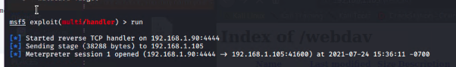
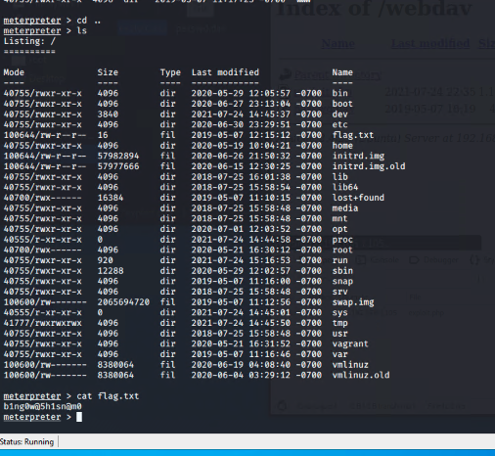
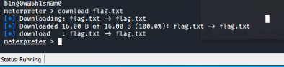
Exploitation: [Remote Code Execution]
01
02
03
Tools & Processes
Metasploit
Meterpreter
Reverse TCP Shell
Achievements
We were able to establish a connection via meterpreter reverse tcp shell.
We were then able to connect and access the web server / download the flag

Slide 11

Blue Team
Log Analysis and Attack Characterization
‹#›

Slide 12

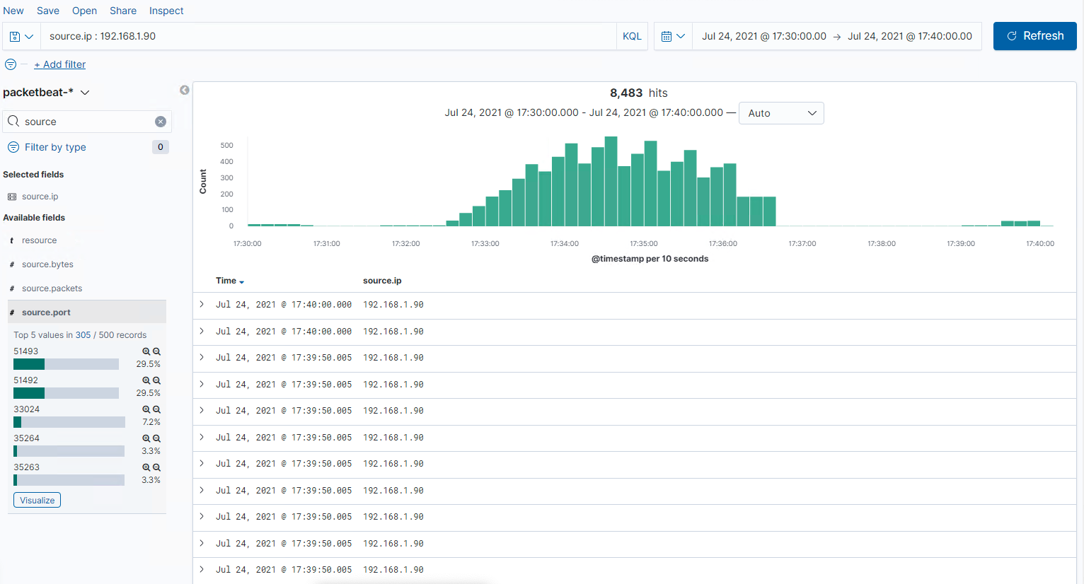
Analysis: Identifying the Port Scan
Answer the following questions in bullet points under the screenshot if space allows. Otherwise, add the answers to speaker notes.
The Port Scan occurred at 5:30pm
8483 Packets were sent from 192.168.1.90
Almost no traffic before 5:33pm and then a huge amount of packets being sent to the server.

Slide 13
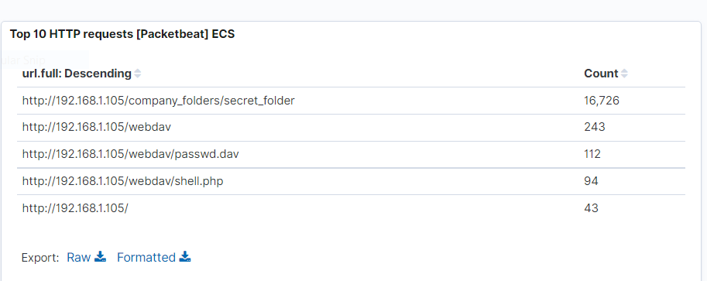
Analysis: Finding the Request for the Hidden Directory
Answer the following questions in bullet points under the screenshot if space allows. Otherwise, add the answers to speaker notes.
What time did the request occur? 6:00pm
How many requests were made? 16726
Which files were requested? Company Folder / Secret Folder
What did they contain? How to Connect to DAV Server

Slide 14
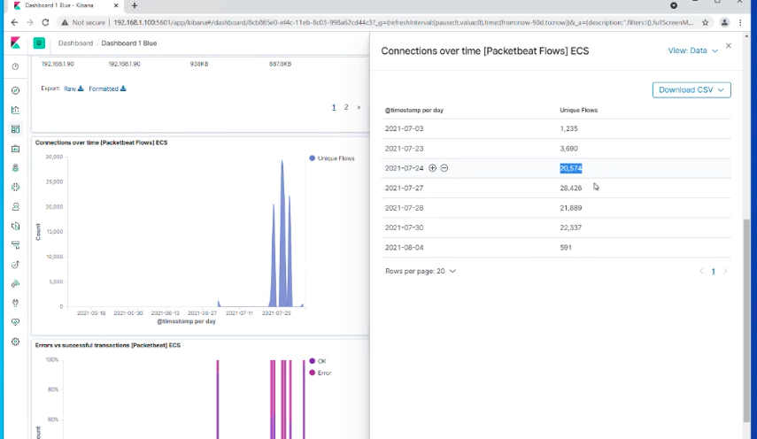
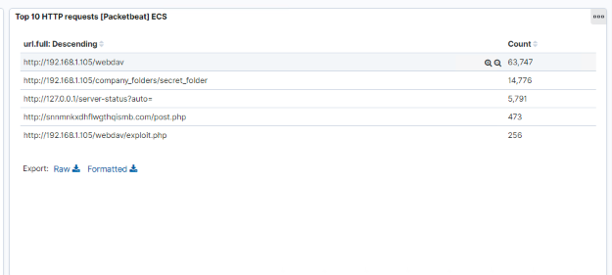
Analysis: Uncovering the Brute Force Attack
Answer the following questions in bullet points under the screenshot if space allows. Otherwise, add the answers to speaker notes.
How many requests were made in the attack? 28,574
How many requests had been made before the attacker discovered the password? 14,778

Slide 15
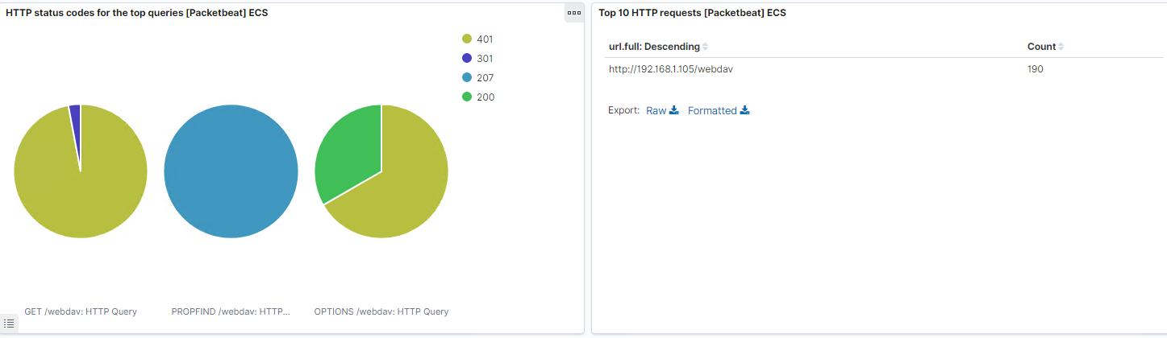
Analysis: Finding the WebDAV Connection
Answer the following questions in bullet points under the screenshot if space allows. Otherwise, add the answers to speaker notes.
How many requests were made to this directory? 190
Which files were requested? Campany_folders / webdav / shell.php
[Insert Here
Add a screenshot of Kibana logs depicting the WebDAV connection.

Slide 16
Blue Team
Proposed Alarms and Mitigation Strategies
‹#›

Slide 17
Mitigation: Blocking the Port Scan
What configurations can be set on the host to mitigate port scans?
Set and IPS alarm that can blacklist IP addresses that trigger alarms multiple times.
Describe the solution. If possible, provide required command lines.
If possible you can use UFW (Uncomplicated Firewall) and specify rules.
sudo ufw allow <port>/<optional:protocol>
What kind of alarm can be set to detect future port scans?
Set a Post-Get IDS alarm in all TCP and UDP ports.
What threshold would you set to activate this alarm?
If more than 10 packet requests come in from an IP address alarm will trigger.

Slide 18
Mitigation: Finding the Request for the Hidden Directory
What kind of alarm can be set to detect future unauthorized access?
An alert when badlogins occur that looks the folder/account until, IT is able to reset the password securely.
What threshold would you set to activate this alarm?
5 bad logins
What configuration can be set on the host to block unwanted access?
A setting on your firewall that locks your account when you have 5 bad login attempts
Describe the solution. If possible, provide required command lines.
Set this rule up on your firewall in the cloud network.

Slide 19
Mitigation: Preventing Brute Force Attacks
What kind of alarm can be set to detect future brute force attacks?
Setting an alert for get requests that exceed a certain number
What threshold would you set to activate this alarm?
10 get requests
What configuration can be set on the host to block brute force attacks?
After ten requests to the folder. The folder locks.
Describe the solution. If possible, provide the required command line(s).
System administrator are able to unlock the account with two factor authentication system.

Slide 20
Mitigation: Detecting the WebDAV Connection
What kind of alarm can be set to detect future access to this directory?
An alert for an ip address not belonging to ryan trying to access the file
What threshold would you set to activate this alarm?
Any successful login attempt from non recognized IP address.
What configuration can be set on the host to control access?
Access Control Permissions (ACLs)
Describe the solution. If possible, provide the required command line(s).
Only allow Ryan’s known IP address to access / upload files to the DAV web Server / user add ryan chmod + 444 (read only unless admin)

Slide 21
Mitigation: Identifying Reverse Shell Uploads
What kind of alarm can be set to detect future file uploads?
Alert when a login in user with a non whitelisted ip address successfully uploads any file type to the webdav server
What threshold would you set to activate this alarm?
1 file
What configuration can be set on the host to block file uploads?
The alert is triggered when a file is uploaded with known keywords or signatures found in an antivirus detector
Describe the solution. If possible, provide the required command line.
Configure Crowdstrike anti-virus to identify signatures and block any uploads with said signatures or keywords (ie /bin/bash).

